Slide 1
AP157 Module A: Machine Learning
Dr. Reina Reyes
February 8, 2024

Slide 2
Overview
In Module A, you will learn machine learning techniques and apply them on real-world astronomical datasets using Python and Jupyter/Google Colaboratory notebooks-- libraries used include numpy, matplotlib, and scikit-learn.
All module set materials, including lab assignment notebooks and datasets, are available in the AP157 Course Pack Google Drive folder.
Topics to be covered are:
Overview of Machine Learning
Regression
Classification
Dimensionality Reduction

Slide 3
References
[SDMMLA Textbook] Statistics, Data Mining, and Machine Learning in Astronomy: A Practical Python Guide for the Analysis of Survey Data by Zeljko lvezic, Andrew J. Connoly, Jacob T. VanderPlas, and Alexander Gray.
Regression - Chapter 8
Classification - Chapter 9
Dimensionality Reduction - Chapter 7
Textbook chapters (PDF) are in the Google Drive folder (under “Resources”)
[IBM Tutorial] Learn regression/classification algorithms using Python and scikit-learn
Regression - https://developer.ibm.com/tutorials/learn-regression-algorithms-using-python-and-scikit-learn/
Classification - https://developer.ibm.com/tutorials/learn-classification-algorithms-using-python-and-scikit-learn/

Slide 4
Overview of
Machine Learning

Slide 5
How does Machine Learning Work?
Train, Test, Deploy
DATA
MODEL
STEP 1:
Model gets trained by input data.
This is the “learning” aspect of machine learning.

Slide 6
How does Machine Learning Work?
DATA
MODEL
Train, Test, Deploy
STEP 2:
Model is tested on new data.
This determines the model’s performance.
OUTPUT
Is it correct?

Slide 7
How does Machine Learning Work?
DATA
MODEL
Train, Test, Deploy
STEP 3:
If performance is acceptable, the model is deployed.
Model output from incoming data leads to decision/action point.
DECISION
OUTPUT

Slide 8
A.1 Machine Learning: Regression

Slide 9
OUTLINE: A.1 Regression
Part 1:
A Simple Example
Regression Problem
Simple Linear Regression
Overfitting, Underfitting, and the Bias-Variance Tradeoff
Cross-Validation
Part 2:
Hands-on tutorial on regression to predict California house prices (link)

Slide 10
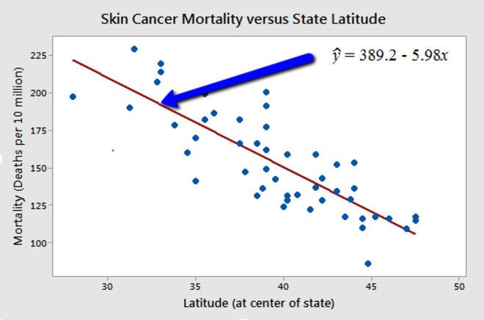
A Simple Example
In statistical modeling, regression analysis is a set of statistical processes for estimating the relationships between a dependent variable (often called the 'outcome variable') and one or more independent variables (often called 'predictors', 'covariates', or 'features').
The most common form of regression analysis is linear regression, in which one finds the line (or a more complex linear combination) that most closely fits the data according to a specific mathematical criterion. (Source: Wikipedia)

Slide 11
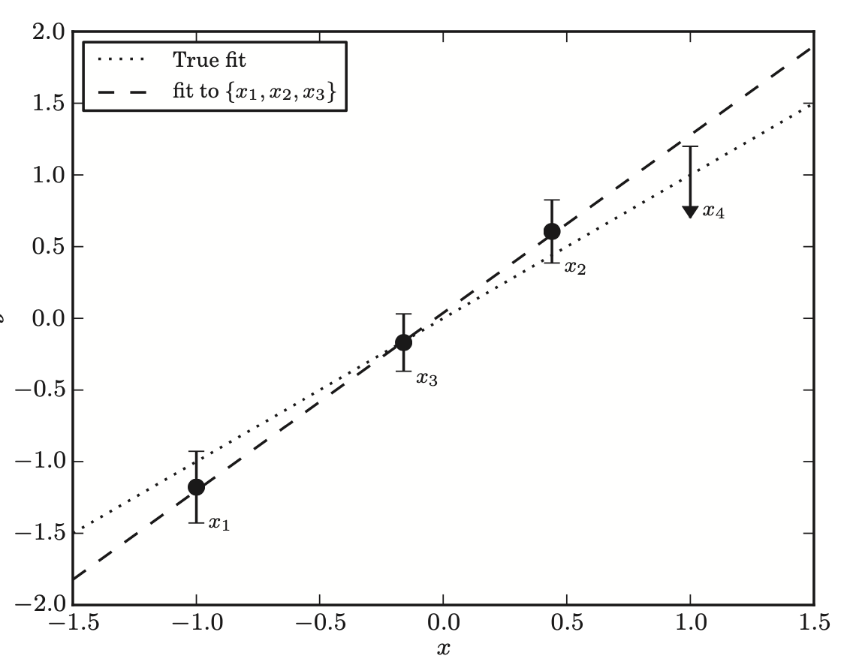
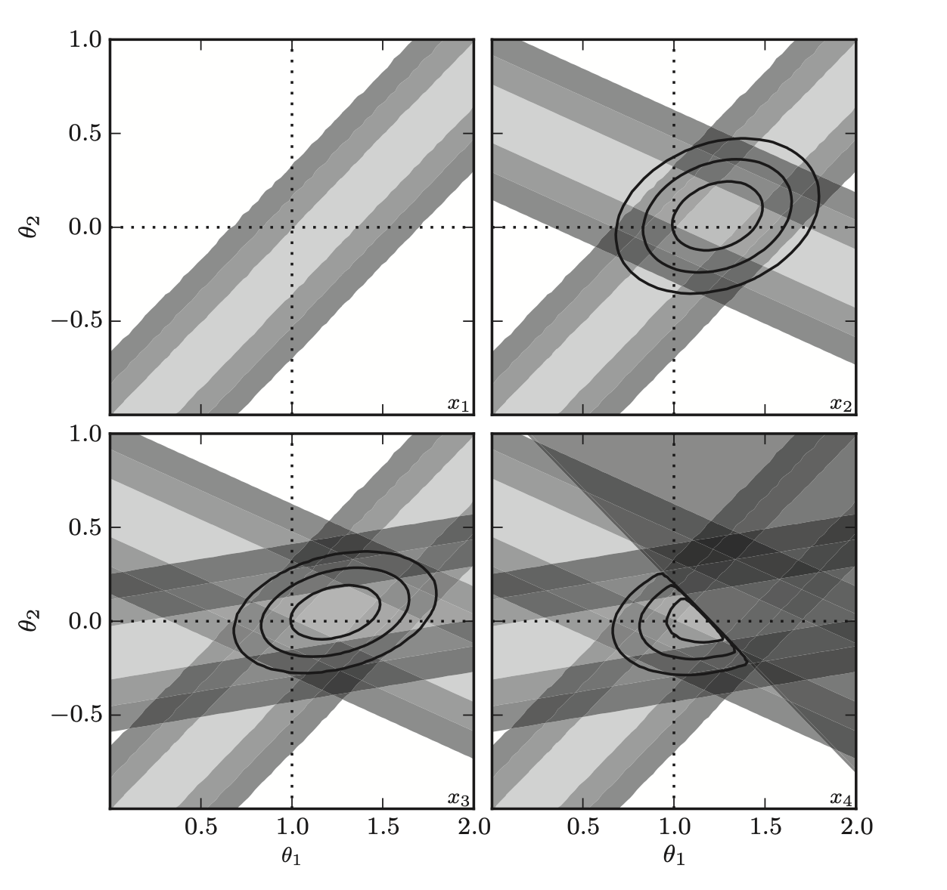
Regression Problem
Q: What is the equation for this line?
y₁ = θ₀ + θ₁*x₁
→ θ₁ = (y₁ - θ₀)/x₁
or θ₀ = y₁ - θ₁*x₁
θ₁
y_{i} = θ₀ + θ₁*x_{i}
θ₁
True fit is line of slope=1 and intercept=0 (Figure 8.1 in SDMMLA)
θ₀
θ₀

Slide 12
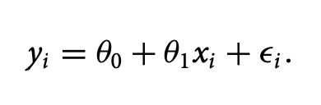
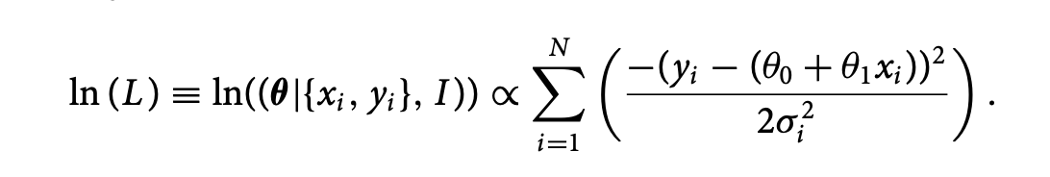
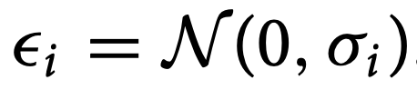
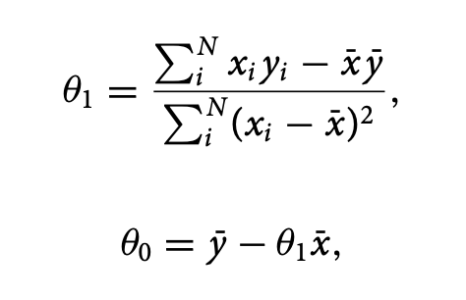
Simple Linear Regression
Linear model for 1 independent variable x & 1 dependent variable y:
Log-likelihood function: Maximizing the log-likelihood as a function of thetas is achieved by minimizing the sum of the square errors. For the case of Gaussian, homoscedastic uncertainties
Homoscedastic means the variance σ_{i} is constant

Slide 13
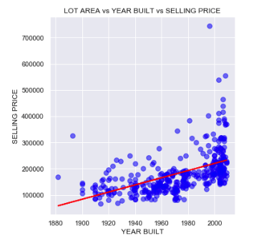
[IBM Tutorial Example] Predicting House Prices

Slide 14
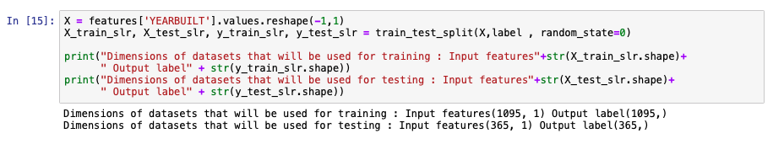
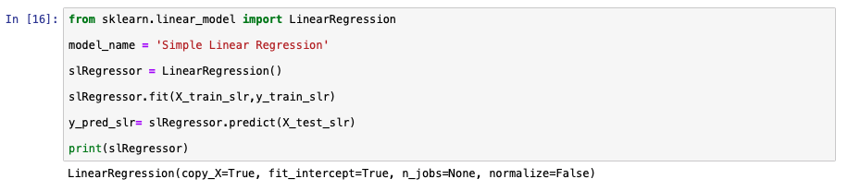
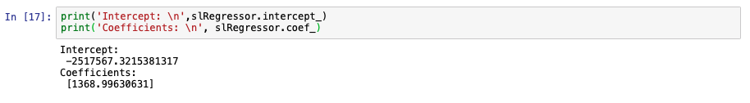

Slide 15
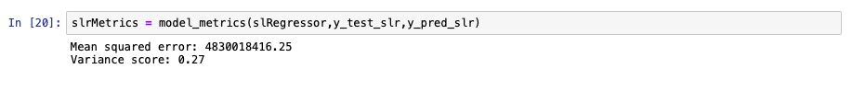
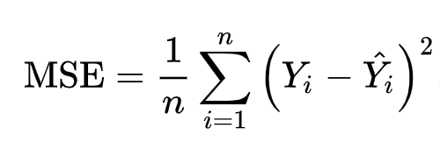
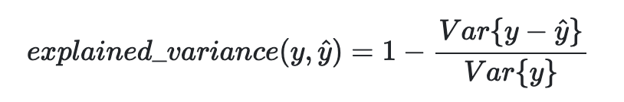
Mean squared error
Explained variance score:

Slide 16
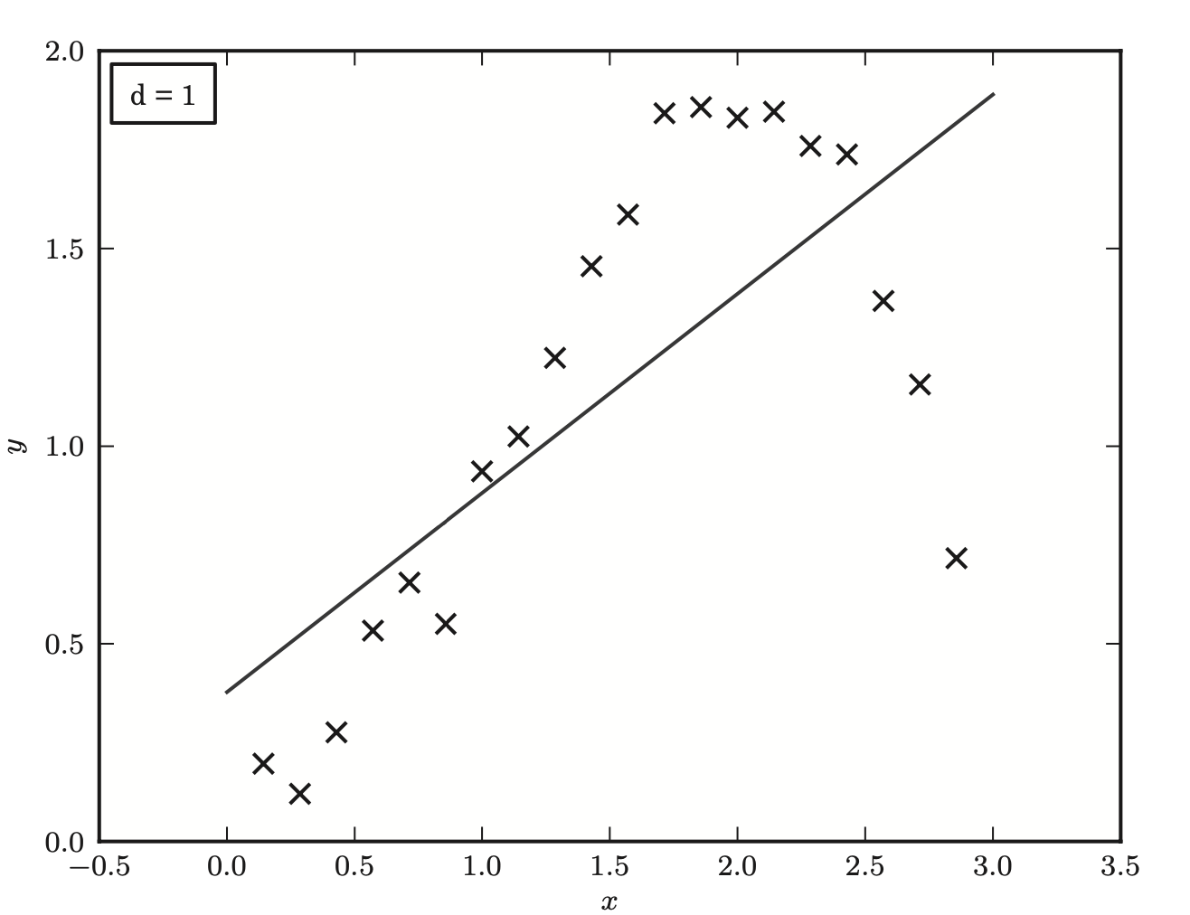
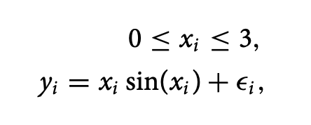

Overfitting and Underfitting
Toy model: where:
Straight-line model is biased, underfits the data (Figure 8.12 in SDMMLA)

Slide 17
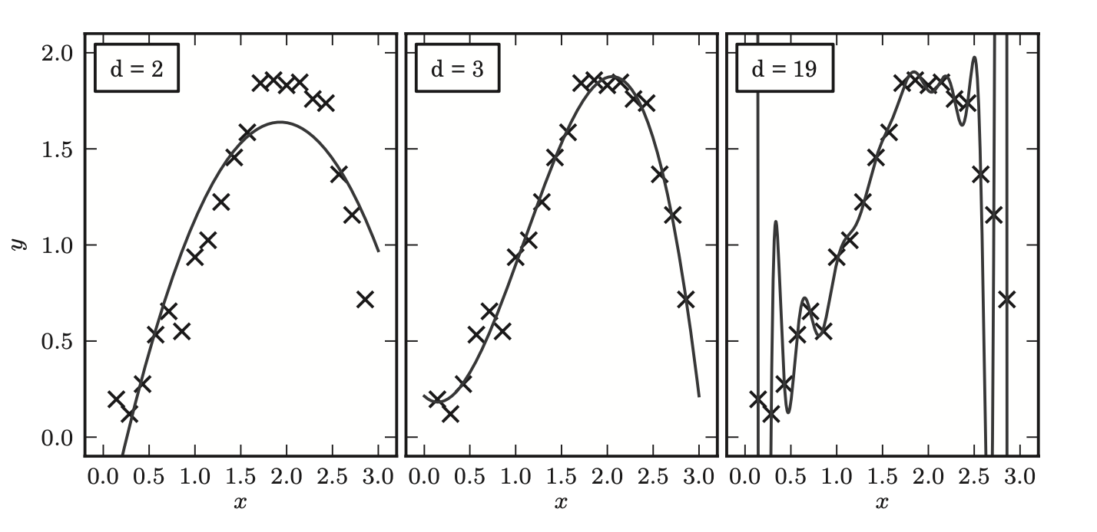
Overfitting and Underfitting
Model underfits the data, suffers from high bias (Figure 8.13 in SDMMLA)
Model balances the tradeoff between bias and variance
Model overfits the data, suffers from high variance

Slide 18
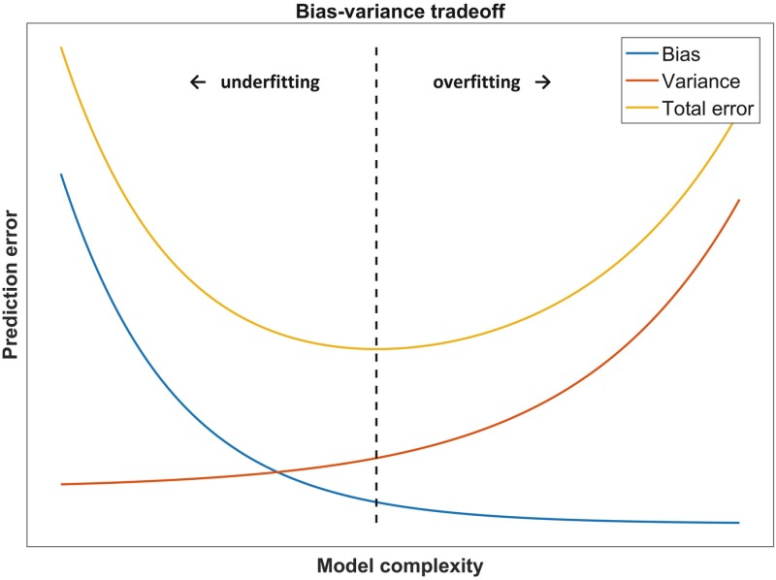
Bias-Variance Tradeoff
Bias relates to the error due to the assumptions made by the algorithm that is chosen for model generation.
The variance is the error due to the amount of overfitting done during model generation.
With increased model complexity the model can more accurately match the underlying relation at the risk of increasing the variance.
The bias-variance tradeoff corresponds to minimizing the total prediction error (which is the sum of bias and variance).
Source: https://www.ncbi.nlm.nih.gov/books/NBK543534/figure/ch8.Fig3/

Slide 19
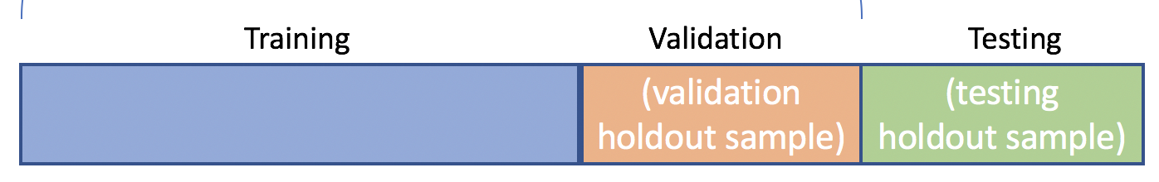
Cross-validation
Split the training data into three parts: the training set, the cross-validation set, and the test set.
As a rule of thumb, the training set should comprise 50–70% of the original training data, while the remainder is divided equally into the cross-validation set and test set.
The training set is used to determine the parameters of a given model
Using the training set, we evaluate the training error
The cross-validation set is used to evaluate the cross-validation error of the model
Because this cross-validation set was not used to construct the fit, the cross-validation error will be large for a high-variance (overfit) model, and better represents the true goodness of fit of the model.
With this in mind, the model which minimizes this cross-validation error is likely to be the best model in practice.
Once this model is determined, the test error is evaluated using the test set.
This test error gives an estimate of the reliability of the model for an unlabeled data set.

Slide 20
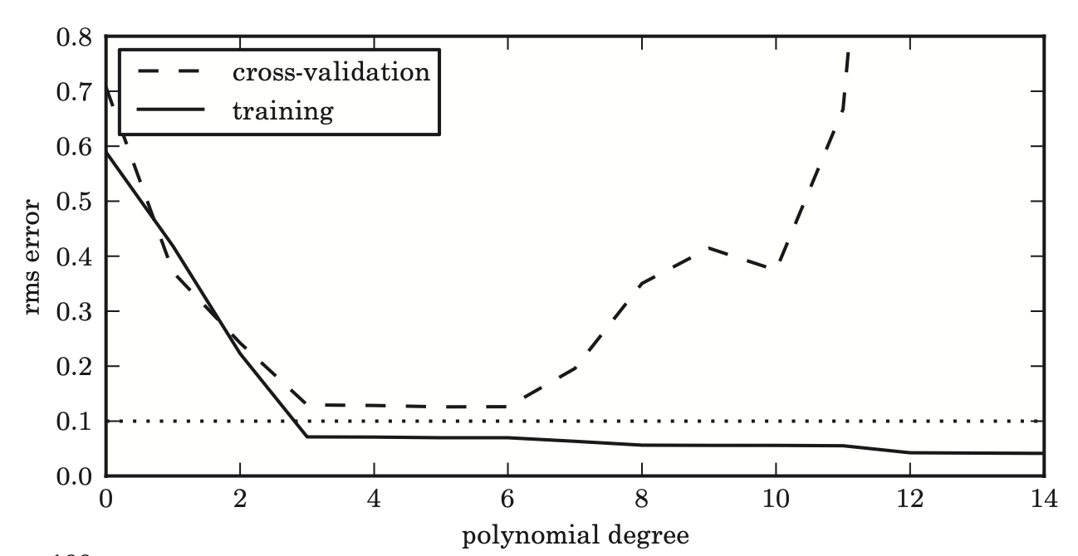
Cross-validation vs. Training Error
Models with polynomial degrees between 3 and 5 minimize the cross-validation error and are optimal; those with smaller degree have high bias, while those with higher degree have high variance
(Figure 8.14 in SDMMLA)

Slide 21
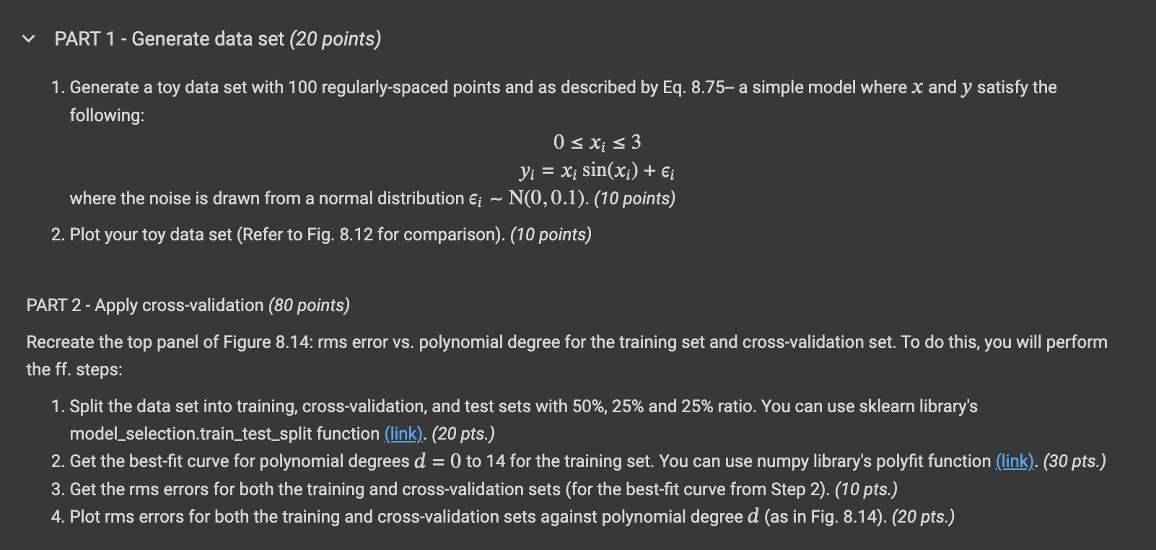
Lab Assignment A.1

Slide 22
SEATWORK EXERCISE (10 points)
Show that for a simple linear regression model, the best-fit slope & intercept are given by: by maximizing the log-likelihood function:
Hint: Take the partial derivative of ln(L) w.r.t. θ₀ and θ₁ and equate both to zero.
Further hint: From the resulting 2 equations, solve for 2 unknowns: θ₀ and θ₁

Slide 23
OUTLINE: A.1 Regression
Part 1:
A Simple Example
Regression Problem
Simple Linear Regression
Overfitting, Underfitting, and the Bias-Variance Tradeoff
Cross-Validation
Part 2:
Hands-on tutorial on regression to predict California house prices (link)

